Slide 1

ONE WKND STUDENT FAQ SHEET
What is One WKND?
One WKND is a time for our students to grow closer to both God and each other through worship sessions, small group bible study, meals, games, and other activities. Adult leaders in our church will be serving as host homes and bible study leaders for our students throughout the weekend. Host Homes will be organized by grade and gender. A complete breakdown of host homes and leaders is provided in this packet. Addresses and phone numbers of host homes and leaders will be available upon request. All of our leaders and host homes will be completing a background check to help ensure the safety of all our students.
Where is One WKND?
Worship sessions will be held at Wallace Memorial Baptist Church (701 Merchant Drive 37912). Host Homes are located throughout the city. You will receive the address of your child’s host home on November 4th at the parent meeting.
When is One WKND?
Students will be dropped off with luggage at Wallace on Friday November 13th at 6:30PM for
registration. They will need to be picked up at our Wallace Campus (701 Merchant Dr. 37912) on Sunday November 15th at Noon.
What is the Cost?
The cost is $50. There is no cost for host homes and leaders. You can sign up at wallacestudents.com.
What Do Students Need to Bring?
Bible, Pen, Notebook, Pillow, Sleeping Bag or Air Mattress, Modest Sleepwear, Towel, and Toiletries.
Snacks/Drinks for homes are optional but not required. Due to many students who have severe nut allergies, we ask that you do not send snacks with nuts/peanut butter. We will all wear our One WKND shirts to church on Sunday morning (students will receive these at their host homes on Saturday night). Please do not bring electronics that will be distracting, inappropriate clothing/memorabilia, weapons/fireworks of any kind, or alcohol/drugs. We will have silent disco on Saturday night, so bring neon clothing.
What Will They Eat?
Students will eat pizza at the church on Friday Night. Host homes will provide breakfast on Saturday and Sunday. We provide lunch and dinner as a large group at Wallace on Saturday.
What About Medications/Food Allergies?
Please provide a detailed schedule of times/dosages/information of medication at registration. If a
student has a food allergy, please list that in that designated place on the online registration form as well. All student participants need to fill out an online 2026 Wallace Students Medical Release Form. If you have already filled out a 2026 Wallace Students form, you do not need to fill out another one (it is good for the entire year of 2026).

Slide 2
ONE WKND STUDENT FAQ SHEET
Can students arrive late on Friday or Saturday morning if they have an activity on Friday night?
Yes. We understand that there may be activities (like football/band) happening on Friday nights that students have a prior commitment. We encourage students to still participate in the weekend and just arrive late on Friday or get dropped off at their host home on Saturday morning. We just ask that you make us aware of your plans ahead of time.
Where can I see the songs being played at the silent disco?
The playlist will be sent to you upon request. Please contact Katherine Green.
What If Students Need to Leave for an Event/Activity and Come Back?
In order for students to get the full experience of the weekend, we do not encourage students to leave during the weekend unless it is an activity with a time conflict that could not be resolved. If students are leaving at any point during the weekend, a parent/guardian will need to turn in a signed Time Away Form at registration.
Can Students Drive Themselves During the Weekend?
Students may drive themselves to the church on Friday night, but we ask that students who drive to leave their cars at the church and ride with our group leaders and host home adults throughout the weekend. Any student with special circumstances who needs to drive during the weekend for any reason needs to fill out a special attention form at check-in. Students cannot drive other students unless it is their immediate family or prior approval has been given.
Who are the Emergency Contact(s)?
Phone numbers of host homes and leaders will be available at registration if needed. Please contact our student ministry team if any serious issue or emergency arises.
Adam Diggs: 865-804-0001
Katherine Green: 904-383-9336
Where do you sign up?
www.wallacestudents.com

Slide 3
ONE WKND DAILY SCHEDULE
WALLACE STUDENTS
Friday November 13
6:30pm – Check in
7:00pm –Dinner in gym
8:00pm – Large Group Worship Session 1 at Wallace
9:30pm – Depart for Host Homes
10:00pm – Small Group Session 1 in Host Homes
Midnight – Lights Out (Hopefully)
Saturday November 14
8:30am – Breakfast in Homes
9:30am – Small Group Session 2 in Host Homes
10:30am – Depart for Wallace
11:00am – Morning activity
12:00pm – Lunch
1:00pm – Small Group Session 3 at Wallace
2:15pm – Squad Wars
4:15pm – Send to host homes for clean up & chill
6:00pm – Large Group Dinner at Wallace
7:00pm – Large Group Worship Session 2 at Wallace
8:30pm – Small Group Session 4 at Wallace
9:30pm – Late Night Activity – Silent Disco at Wallace (DARK-MODE THEME)
11pm - Depart for Host Homes
Midnight – Lights out
Sunday November 15
8:00am – Breakfast in Homes
9:00am – Leave for Church
9:45am – Meet in the Worship Center for Service (Drop off luggage in connect classes)
11:00am – Large Group Session in Student Center
12:00pm – Pick-Up From Wallace Campus

Slide 4

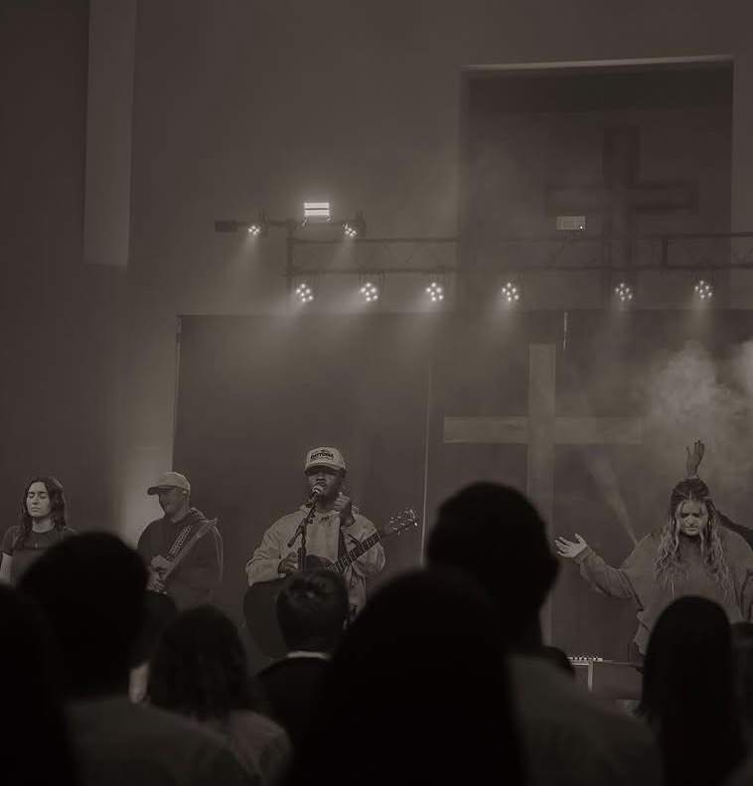
ONE WKND
LARGE GROUP SESSIONS
SPEAKER
Shaq Hardy
PASTOR AND PRESIDENT OF ORPHAN NO MORE FOUNDATION
WORSHIP LEADERS
Servant Co.
KNOXVILLE, TN

